Slide 1


[Title]

Slide 2


Today's agenda
Project recap
Problem
The Analytics team
Process
Insights
Summary

Slide 3

Social Buzz is a rapid growing social network company and digital nature of their core product, the amount of data that they create, collect and must analyze is huge. Accenture is running a 3 month initial project in order to prove to the client that we are the best firm to work with. They are expecting the following:
An audit of their big data practice
Recommendations for a successful IPO
An analysis of their content categories that highlights the top 5 categories with the largest aggregate popularity
Project Recap

Slide 4

Problem
Every day over 100,000 pieces of content, ranging from text, images, videos and GIFs are posted.
365,00,000 contents every year.
An analysis of their content categories that highlights the top 5 categories with the largest aggregate popularity

Slide 5



Andrew Fleming
Chief Technology Architect
The Analytics team
Marcus Rompton
Senior Principal
Nyi Nyi Bo
Data analyst

Slide 6
Process
1
Project background and data understanding
2
Data Cleaning
3
Data merging and modeling
4
Data analysis
5
Useful Insight

Slide 7

Insights

Slide 8
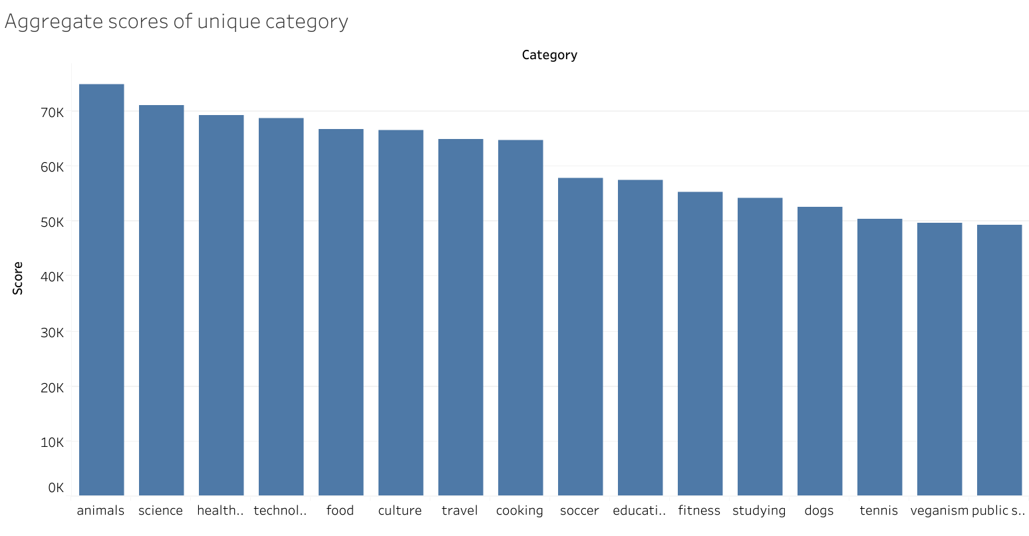

Slide 9
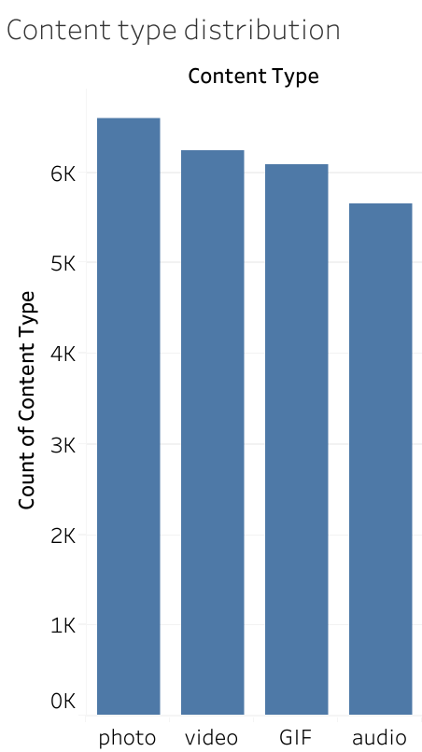

Slide 10
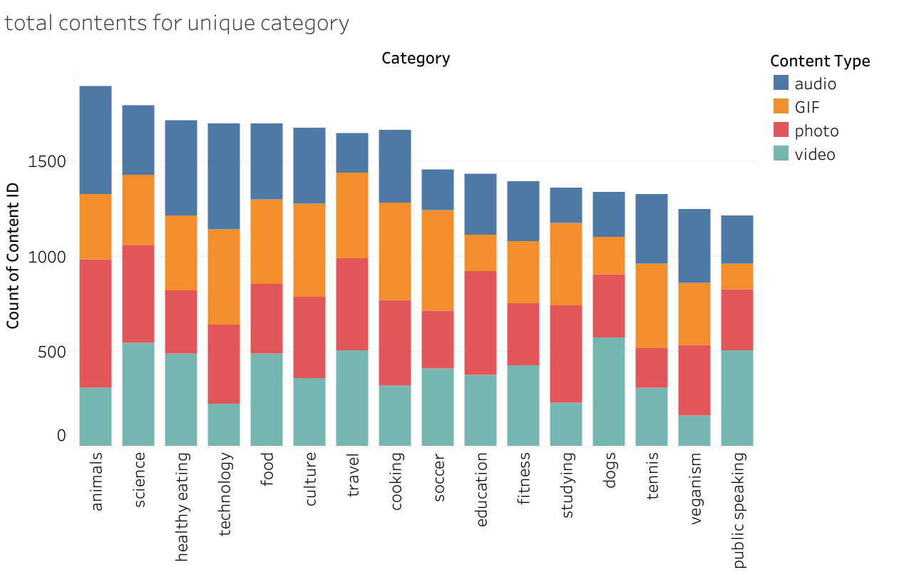

Slide 11
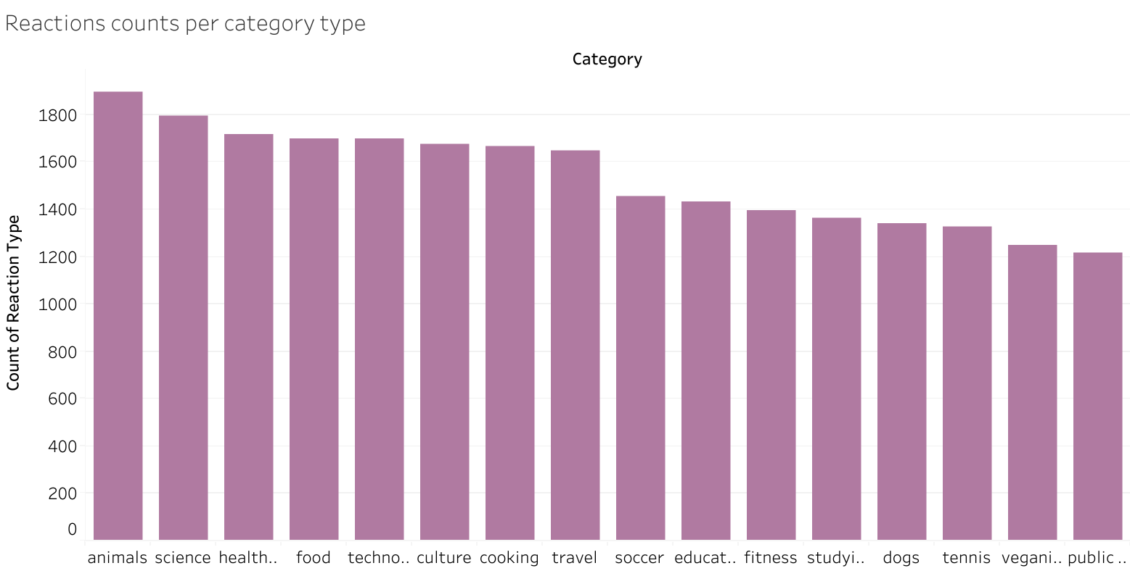

Slide 12
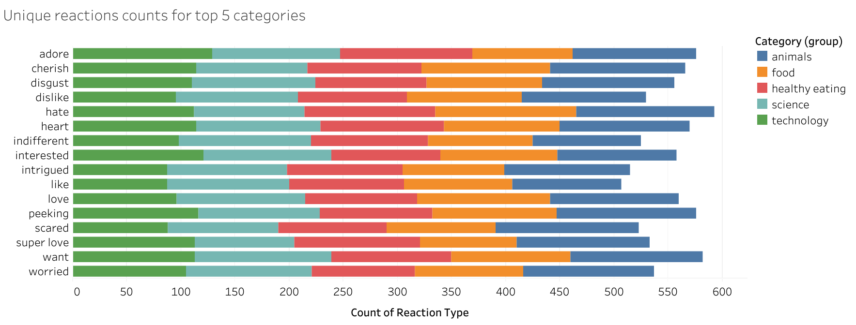

Slide 13
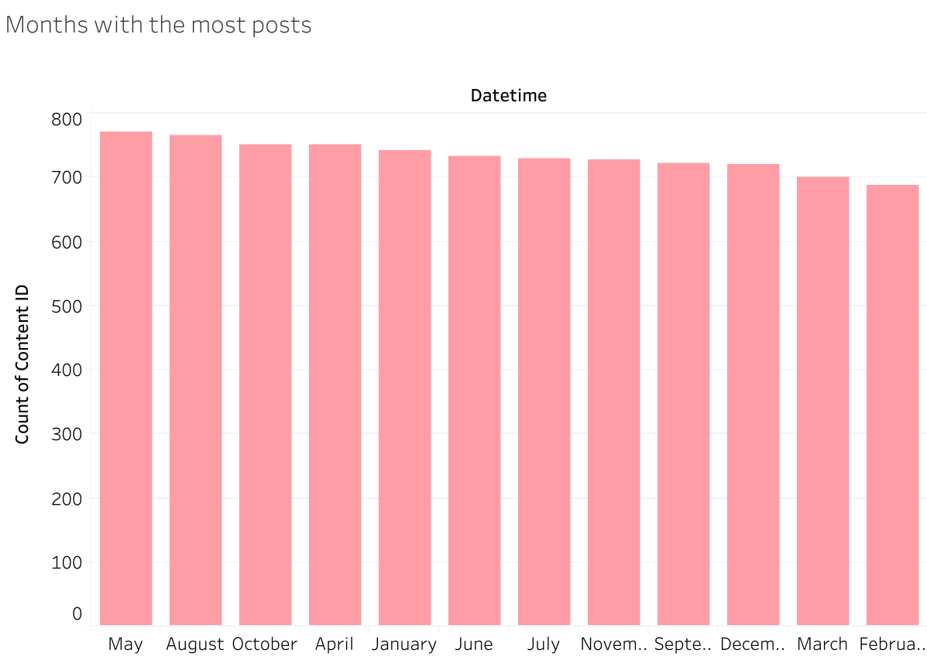

Slide 14

Summary

Slide 15
Thank you!
ANY QUESTIONS?

